Slide 1

REAL ESTATE DATA ANALYSIS PROJECT
BY: GROUP 8

Slide 2
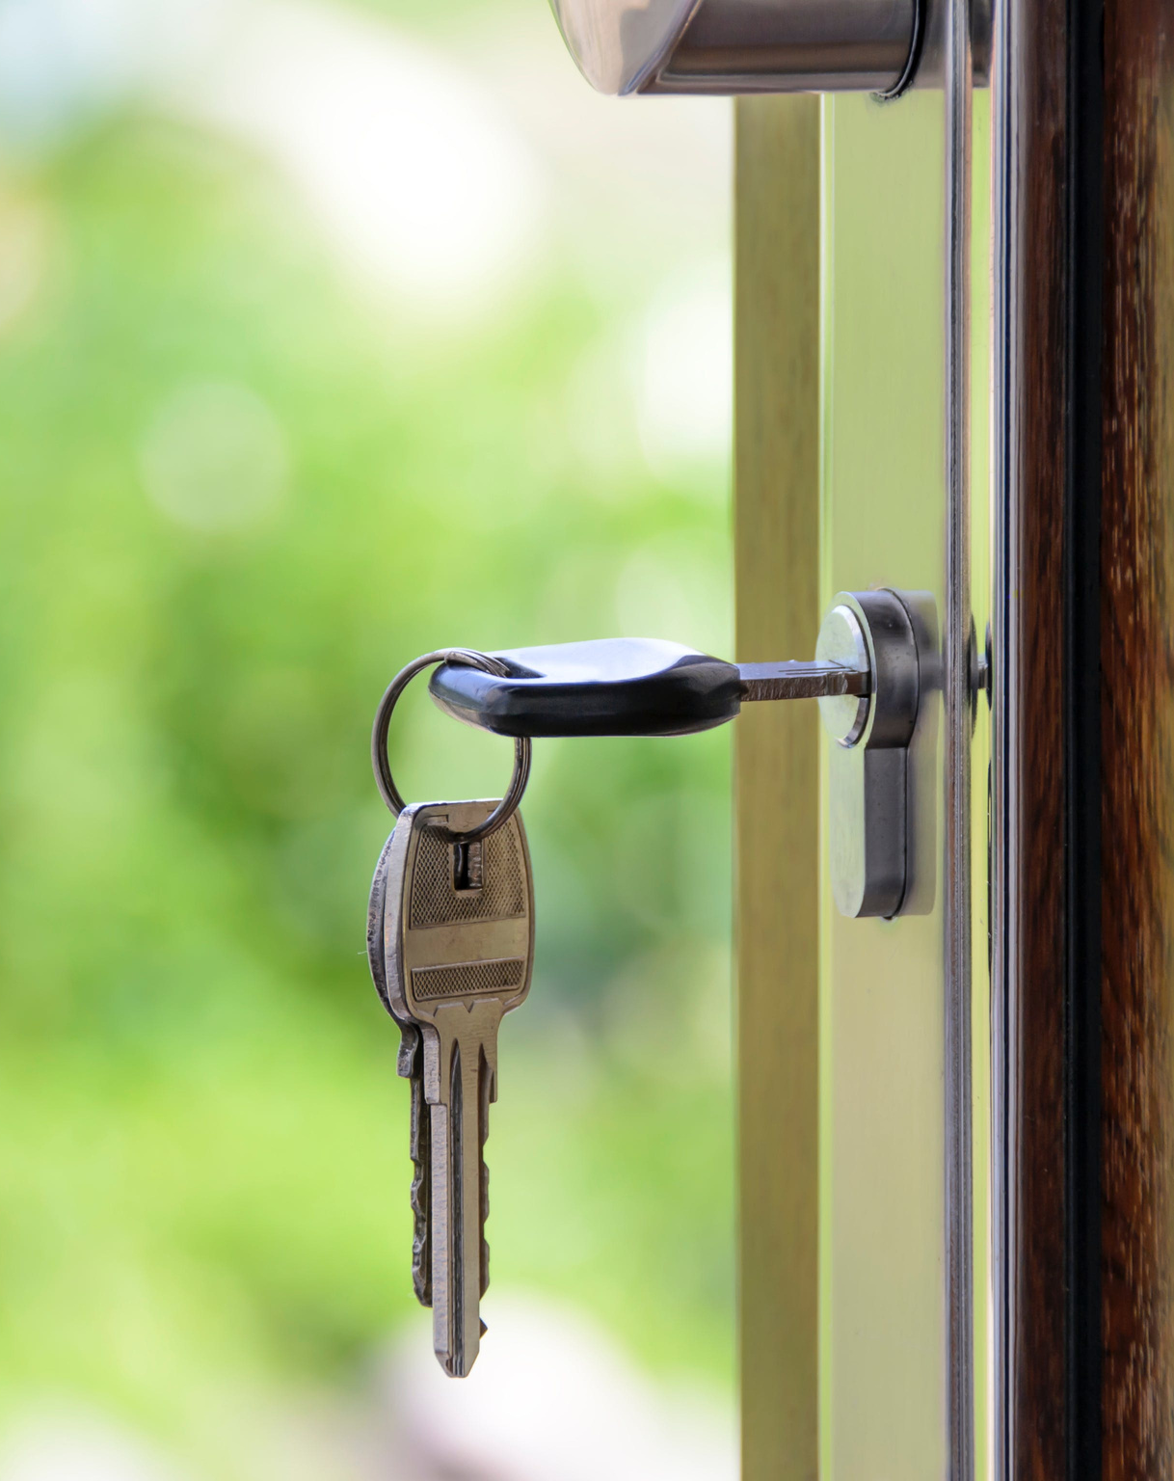
PROJECT SUMMARY
Employing multiple linear regression, our project delved into house sales dynamics in Northwestern County. Recognizing homeowners' struggles in comprehending pricing determinants, we aimed to create a user-friendly tool. Our analysis uncovered a positive correlation between house prices and specific factors: living room square footage, house grade, and bathroom count. These findings elucidate key influences on property values, empowering homeowners with strategic insights in this competitive real estate market.

Slide 3

OUTLINE
1) Business Problem
2) Data
3) Methods
4) Results
5) Conclusion

Slide 4

BUSINESS PROBLEM
Homeowners in Northwestern County are faced with the complex task of understanding the various elements that impact the pricing of their homes. There is a need for a user-friendly tool that simplifies this complexity, offering homeowners clear insights into the factors influencing house prices and how they can strategically make changes in their properties in order sell them at higher prices or rather reasonable prices in the market.

Slide 5

DATA
This project uses the King County House Sales dataset, which can be found in kc_house_data.csv in the data folder in the GitHub repository. The description of the column names can be found in column_names.md in the same folder.

Slide 6

METHOD
The project followed a standard machine learning workflow:
1. Data Loading & Cleaning
2. Exploratory Data Analysis
3. Preprocessing & Feature Engineering
4. Model Development & Evaluation
5. Model Optimization

Slide 7
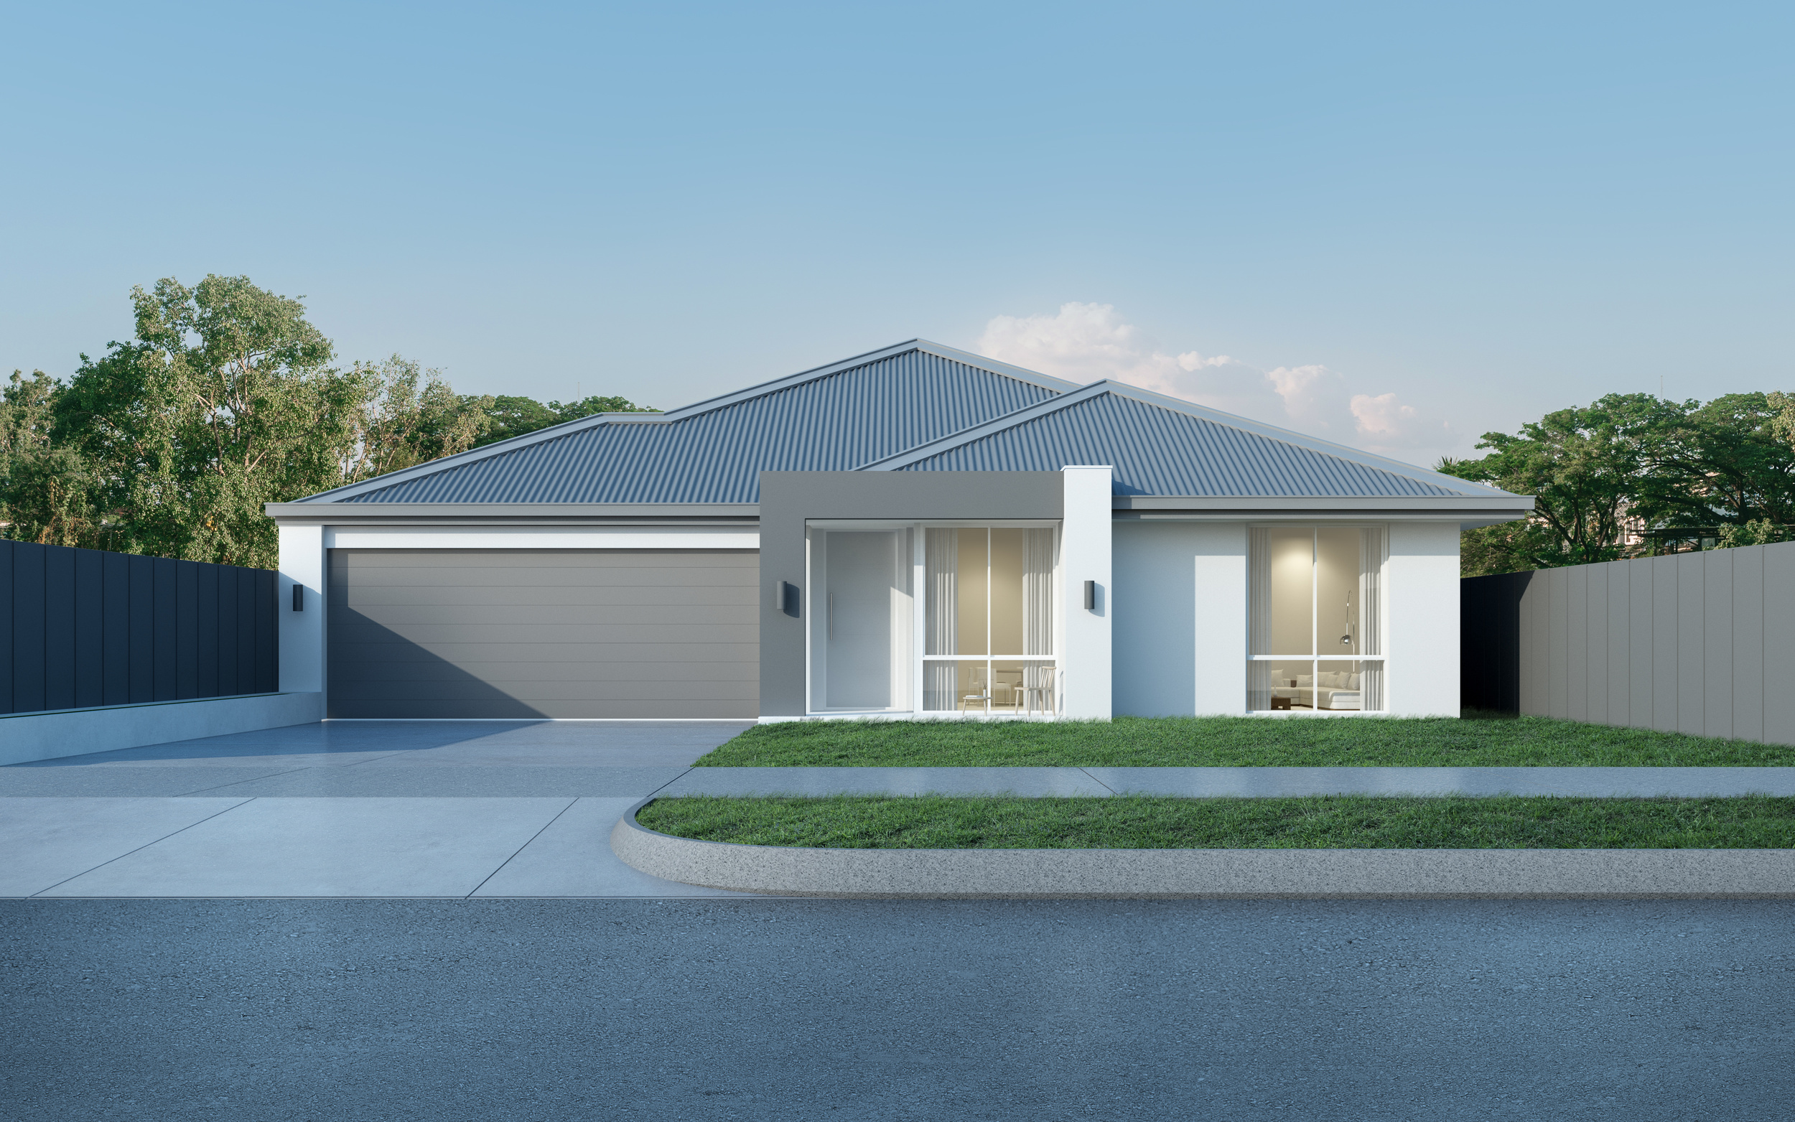

Salford & Co.
RESULTS
Real Estate Presentation

Slide 8
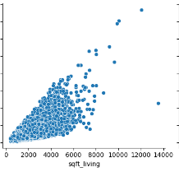
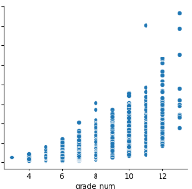
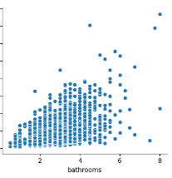
Scatter Plot 02
Scatter plot showing correlation between price variable and number of bathrooms Variable.
Scatter Plot 01
Scatter Plot 03
Scatter plot showing correlation between price variable and Square foot of living room Variable.
Scatter plot showing correlation between price variable and house grade Variable.

Slide 9
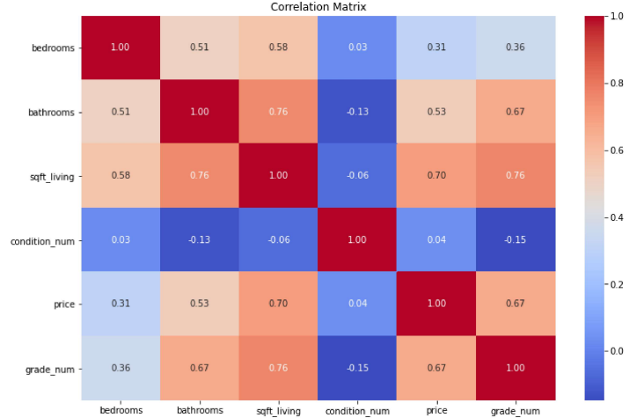
HEATMAP DIAGRAM

Slide 10
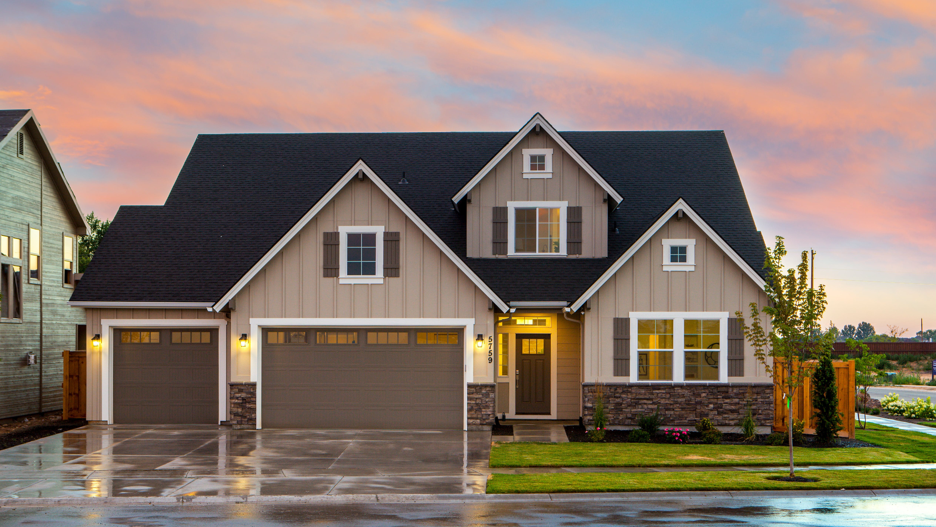
RECOMMENDATIONS
Salford & Co.
Real Estate Presentation

Slide 11
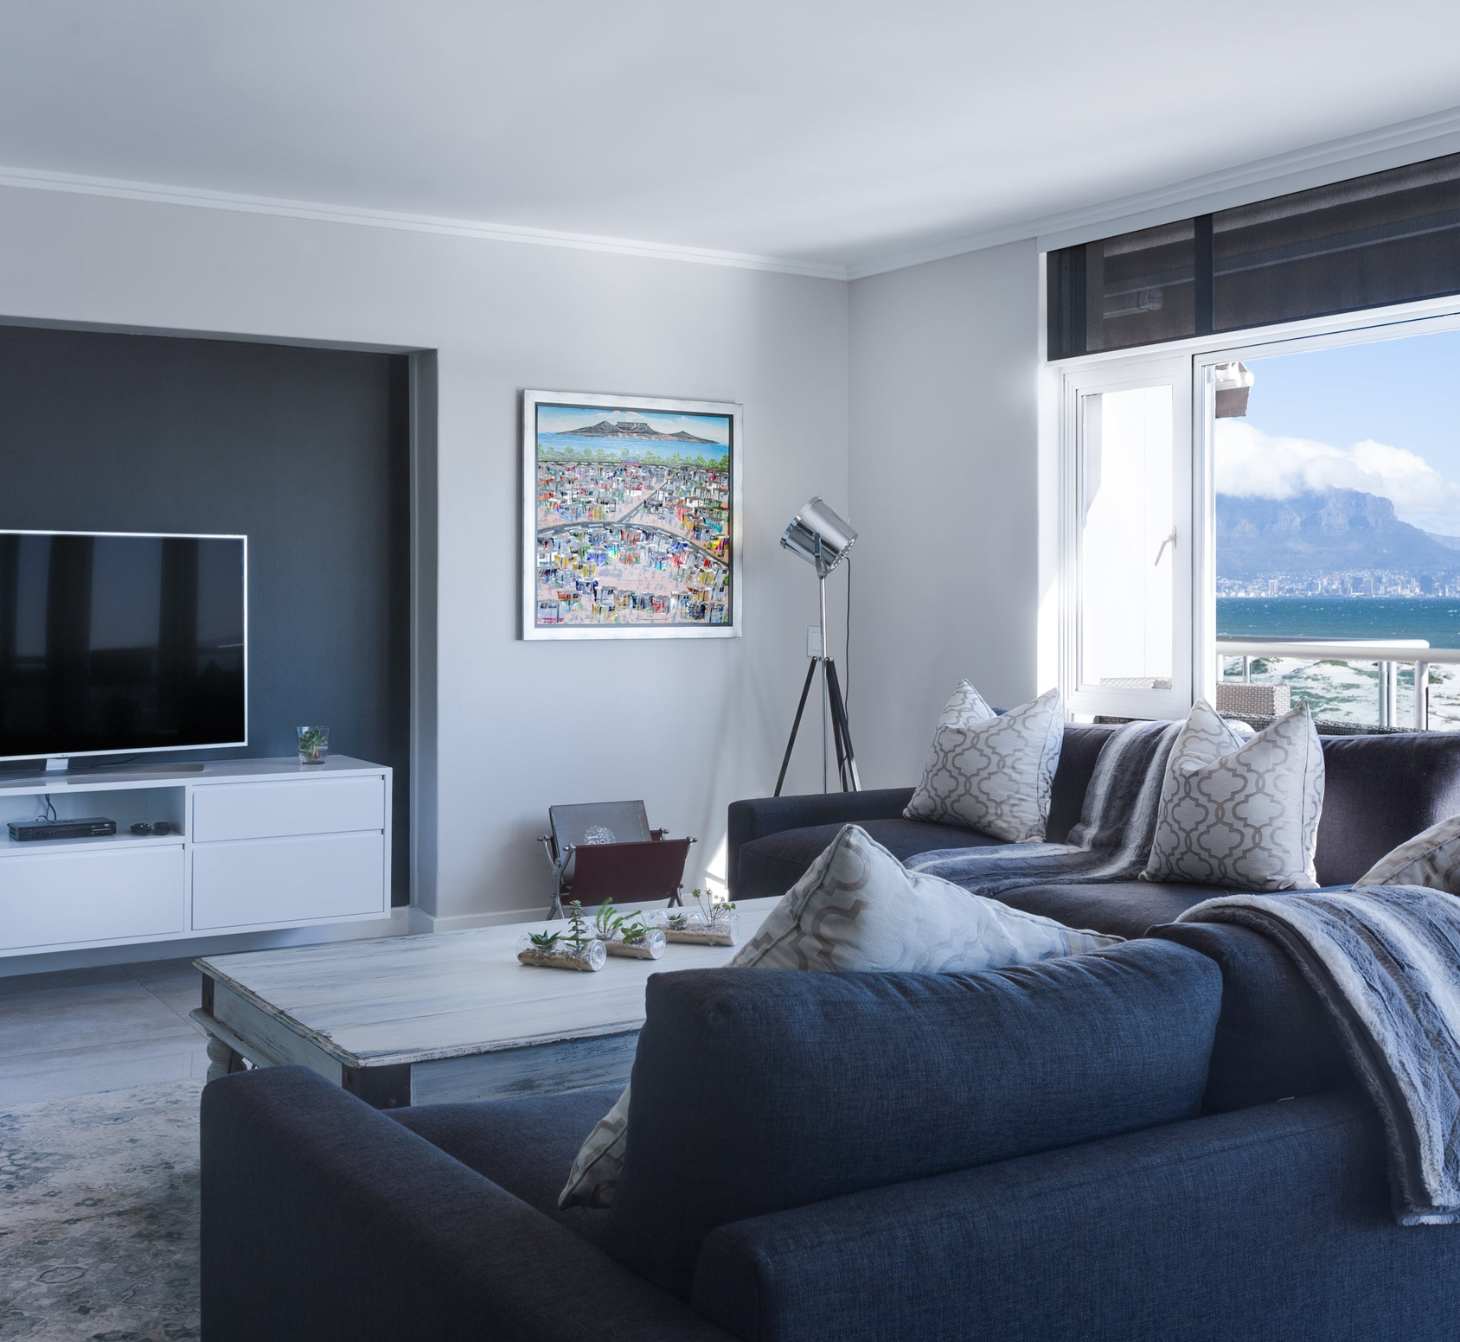
1) Increasing The Square Foot of living room
We recommend that the homeowner increases the the square foot of their living room if they want to get a higher price from their property.
This is based on the analysis which we conducted that showed that there is a clear correlation between size of living roon and the price of the property.

Slide 12
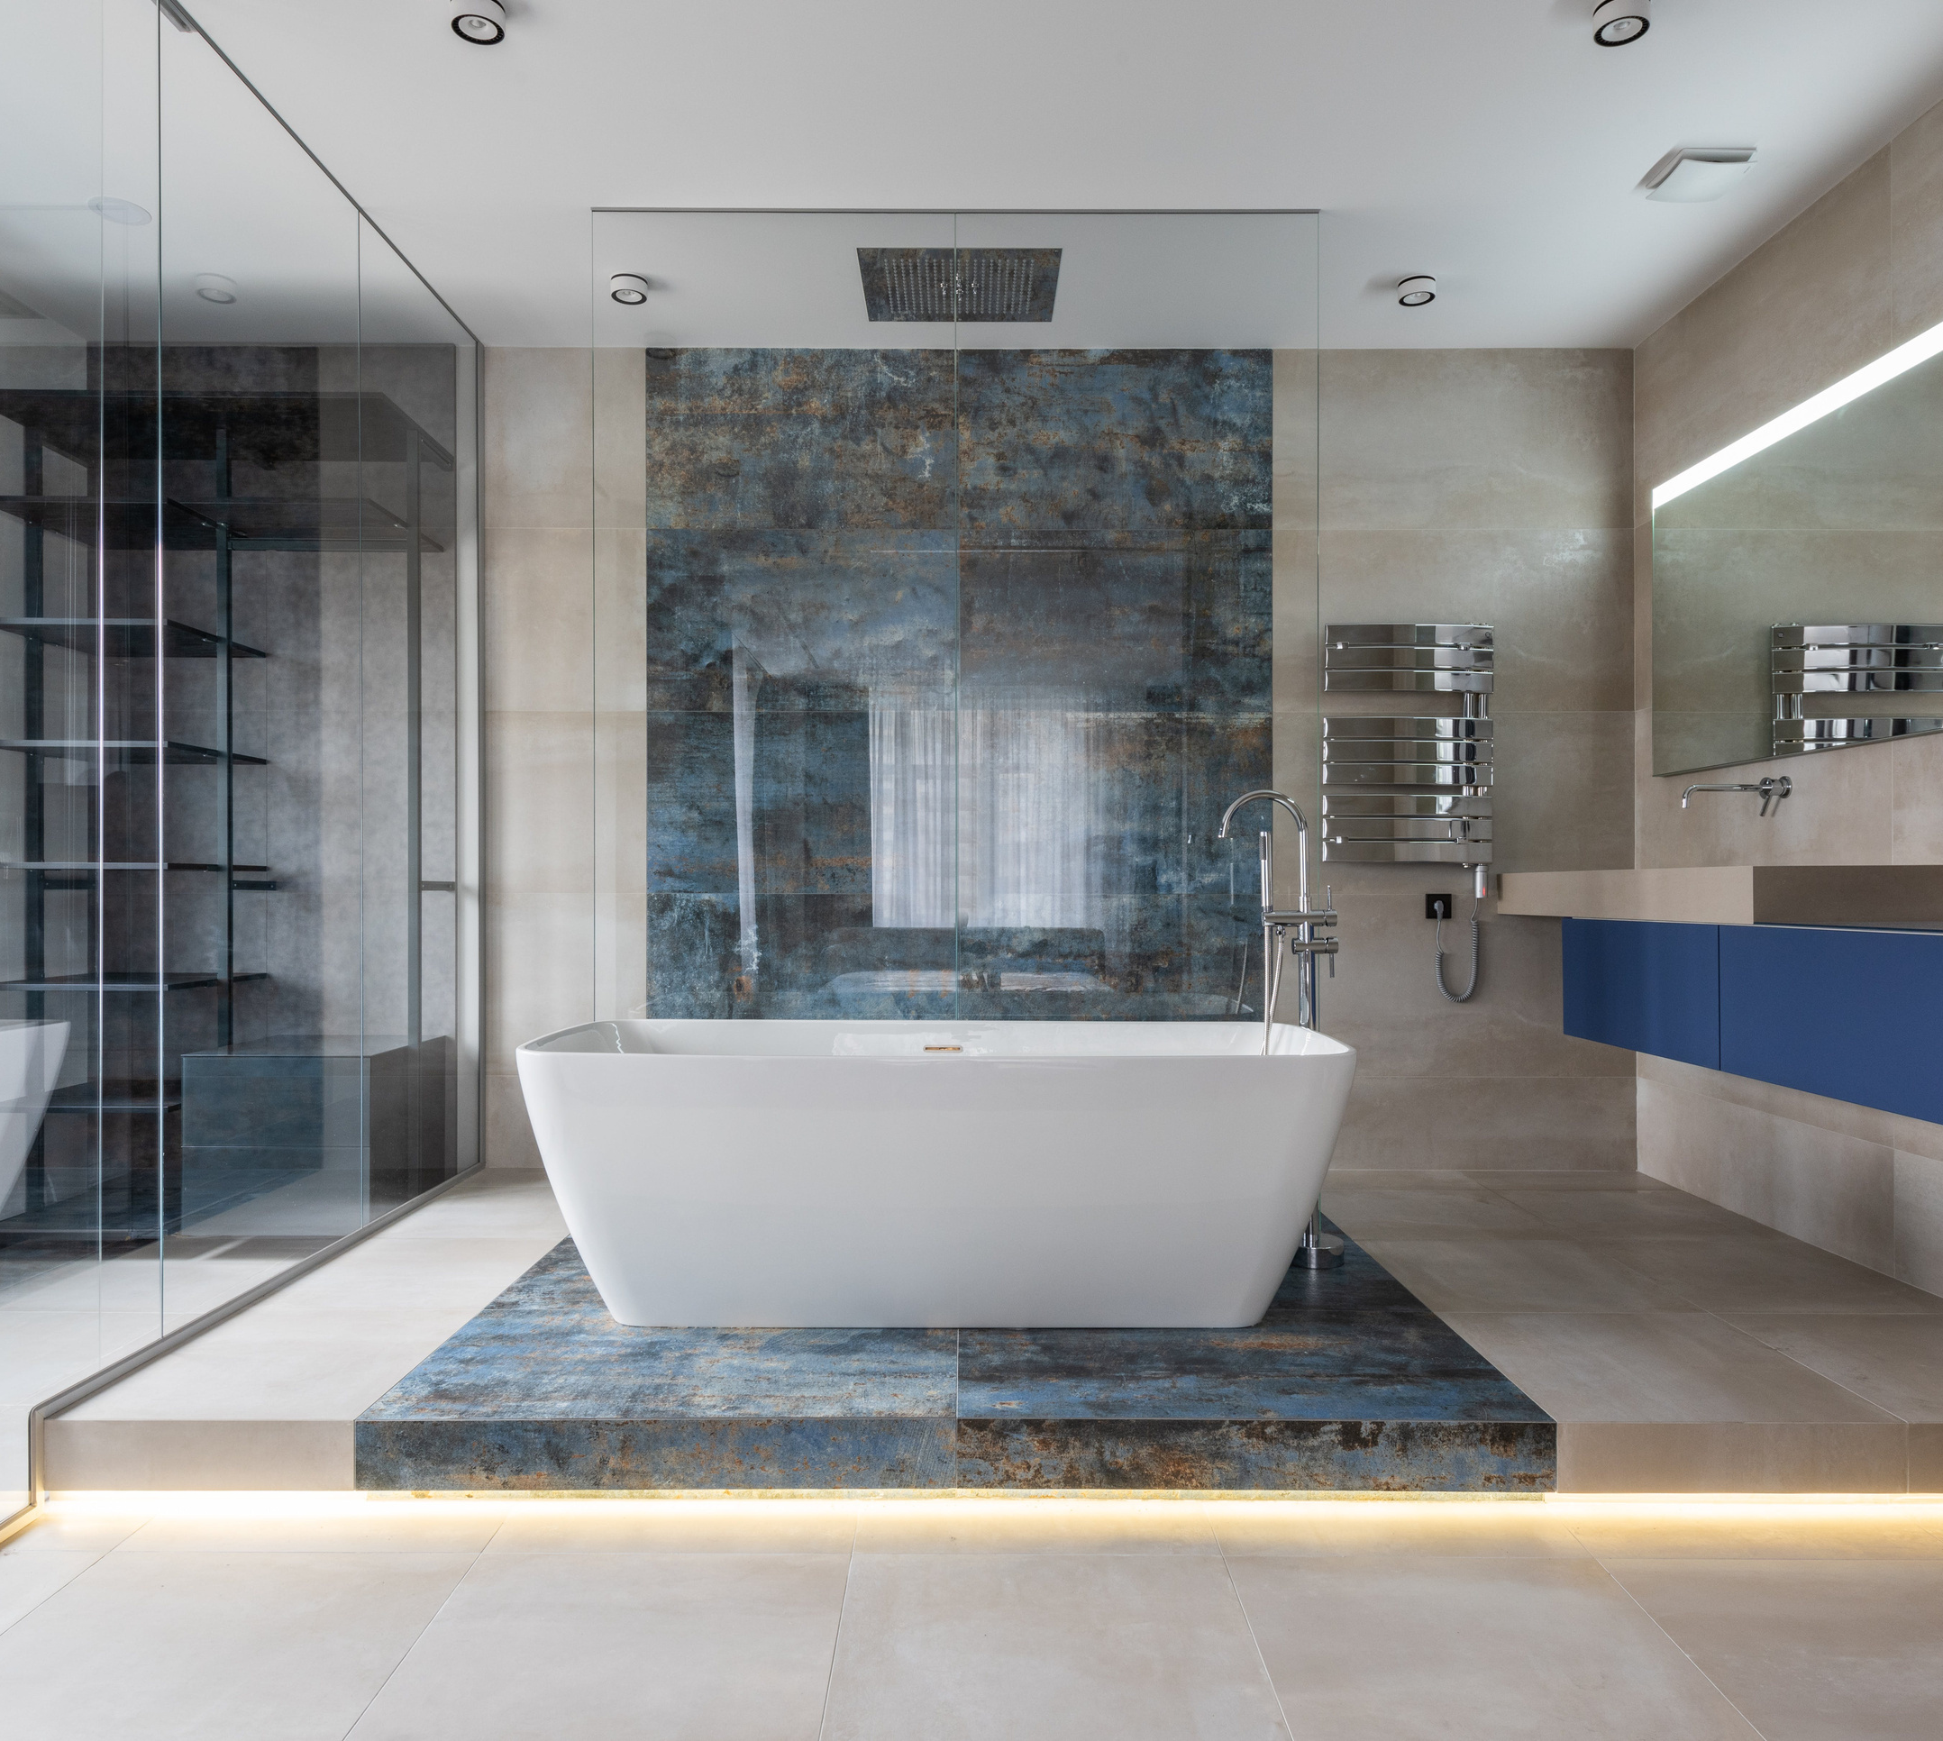
2) Increasing The Number of Bathrooms
We recommend that the homeowner increases the number of bathrooms within the property if they want to get a higher price from the sale of the property.
This is based on the analysis which we conducted that showed that there is a clear correlation between number of bathrooms and the price of the property.

Slide 13
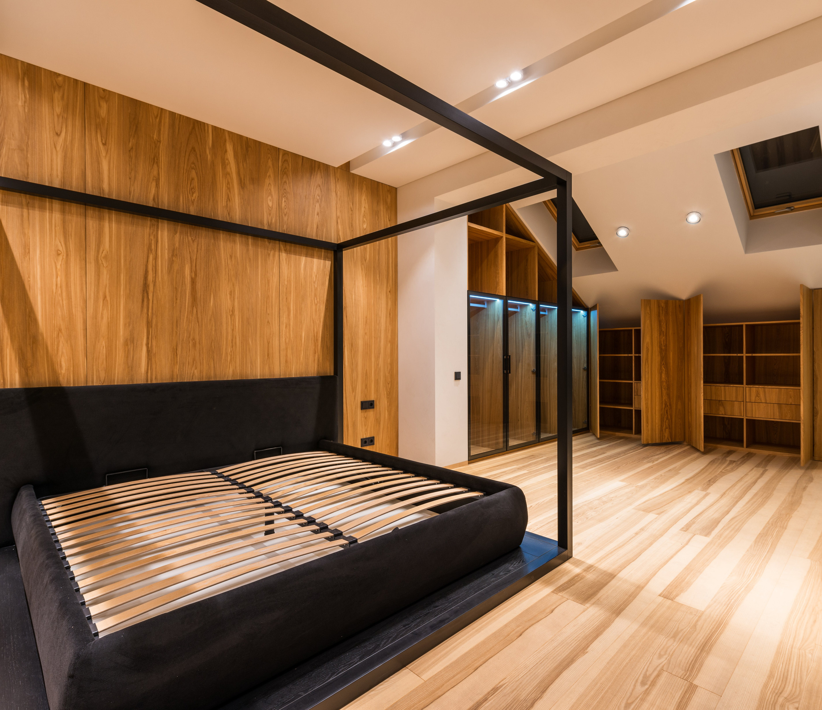
3) Improving the grade of the property
We recommend that the homeowner should improve te grade of the property in order to get higher return from the sale
House grade is based on oerall construction and design of the house
From the analysis we saw that there is a clear correlation between the grade and price of the property

Slide 14

NEXT STEPS
Based on the analysis which was conducted, these are the next steps which we recommend
1) Doing further analysis on Data linked to the average costs for increasing living room size, increasing number of bedrooms and improving the grade of the property.
2) Then an analysis should be done on data that clearly indicates the price difference once these factors are improved. Once this is done we will be able to advice whether making the before stated recommendations will lead in an automatic profit for the home owner

Slide 15



MEET THE TEAM
Christabel Atolwa
James Ndiritu
Sydney Mumbo
Lead Data Scientist
Data Scientist
Data Scientist

Slide 16



MEET THE TEAM
Nicholas Njubi
Chepkemoi Mercy
Zacheaus Nyaga
Data Scientist
Data Scientist
Data Scientist

Slide 17
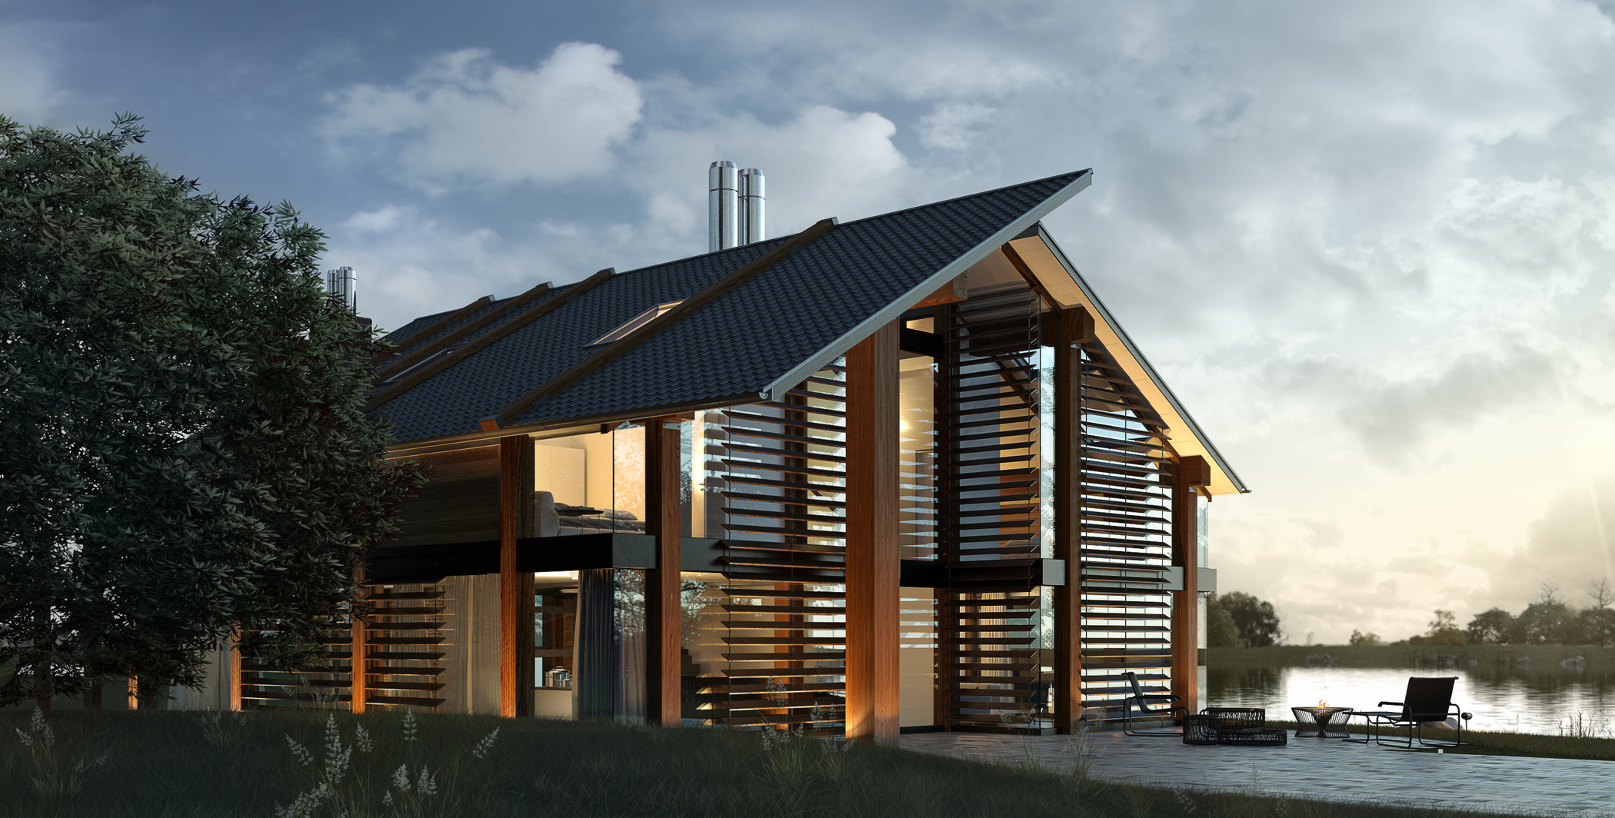
THANK YOU

